Slide 1
IoT Patient Health Monitor System
Real-Time Vital Signs Monitoring Using Blynk and ESP8266
Under the Supervision of,
Mr. Afroz Pasha
Assistant Professor
Presidency School of Computer Science and Engineering
Presidency University
NAME | ROLL NUMBER
SAGAR P | 20221COM0119
DUDDUKURI SRI ADITYA | 20221COM0087

Slide 2
INTRODUCTION
IoT-based healthcare systems enable continuous monitoring of patient vitals
Real-time data collection reduces response time in critical situations
Remote monitoring improves patient outcomes and reduces hospital visits
Affordable and portable solution using embedded microcontrollers

Slide 3
OBJECTIVE
Monitor vital signs: Temperature, Heart Rate, and SpO₂ in real-time
Display readings on local LCD and cloud-based Blynk dashboard
Enable physicians to access patient data remotely via smartphone
Generate automated alerts when vital signs exceed safety thresholds

Slide 4
HARDWARE REQUIREMENTS
Microcontroller: ESP32 or ESP8266 (Wi-Fi connectivity)
Temperature Sensor: DHT11 or DHT22
Heart Rate & SpO₂: MAX30x Pulse Oximeter Module
Display: 16×2 LCD with I2C module
Power Supply: 5V USB power bank or adapter
Jumper Wires: Male-to-male and male-to-female connectors
Breadboard: For circuit prototyping
Additional: Pull-up resistors, capacitors for sensor stability

Slide 5
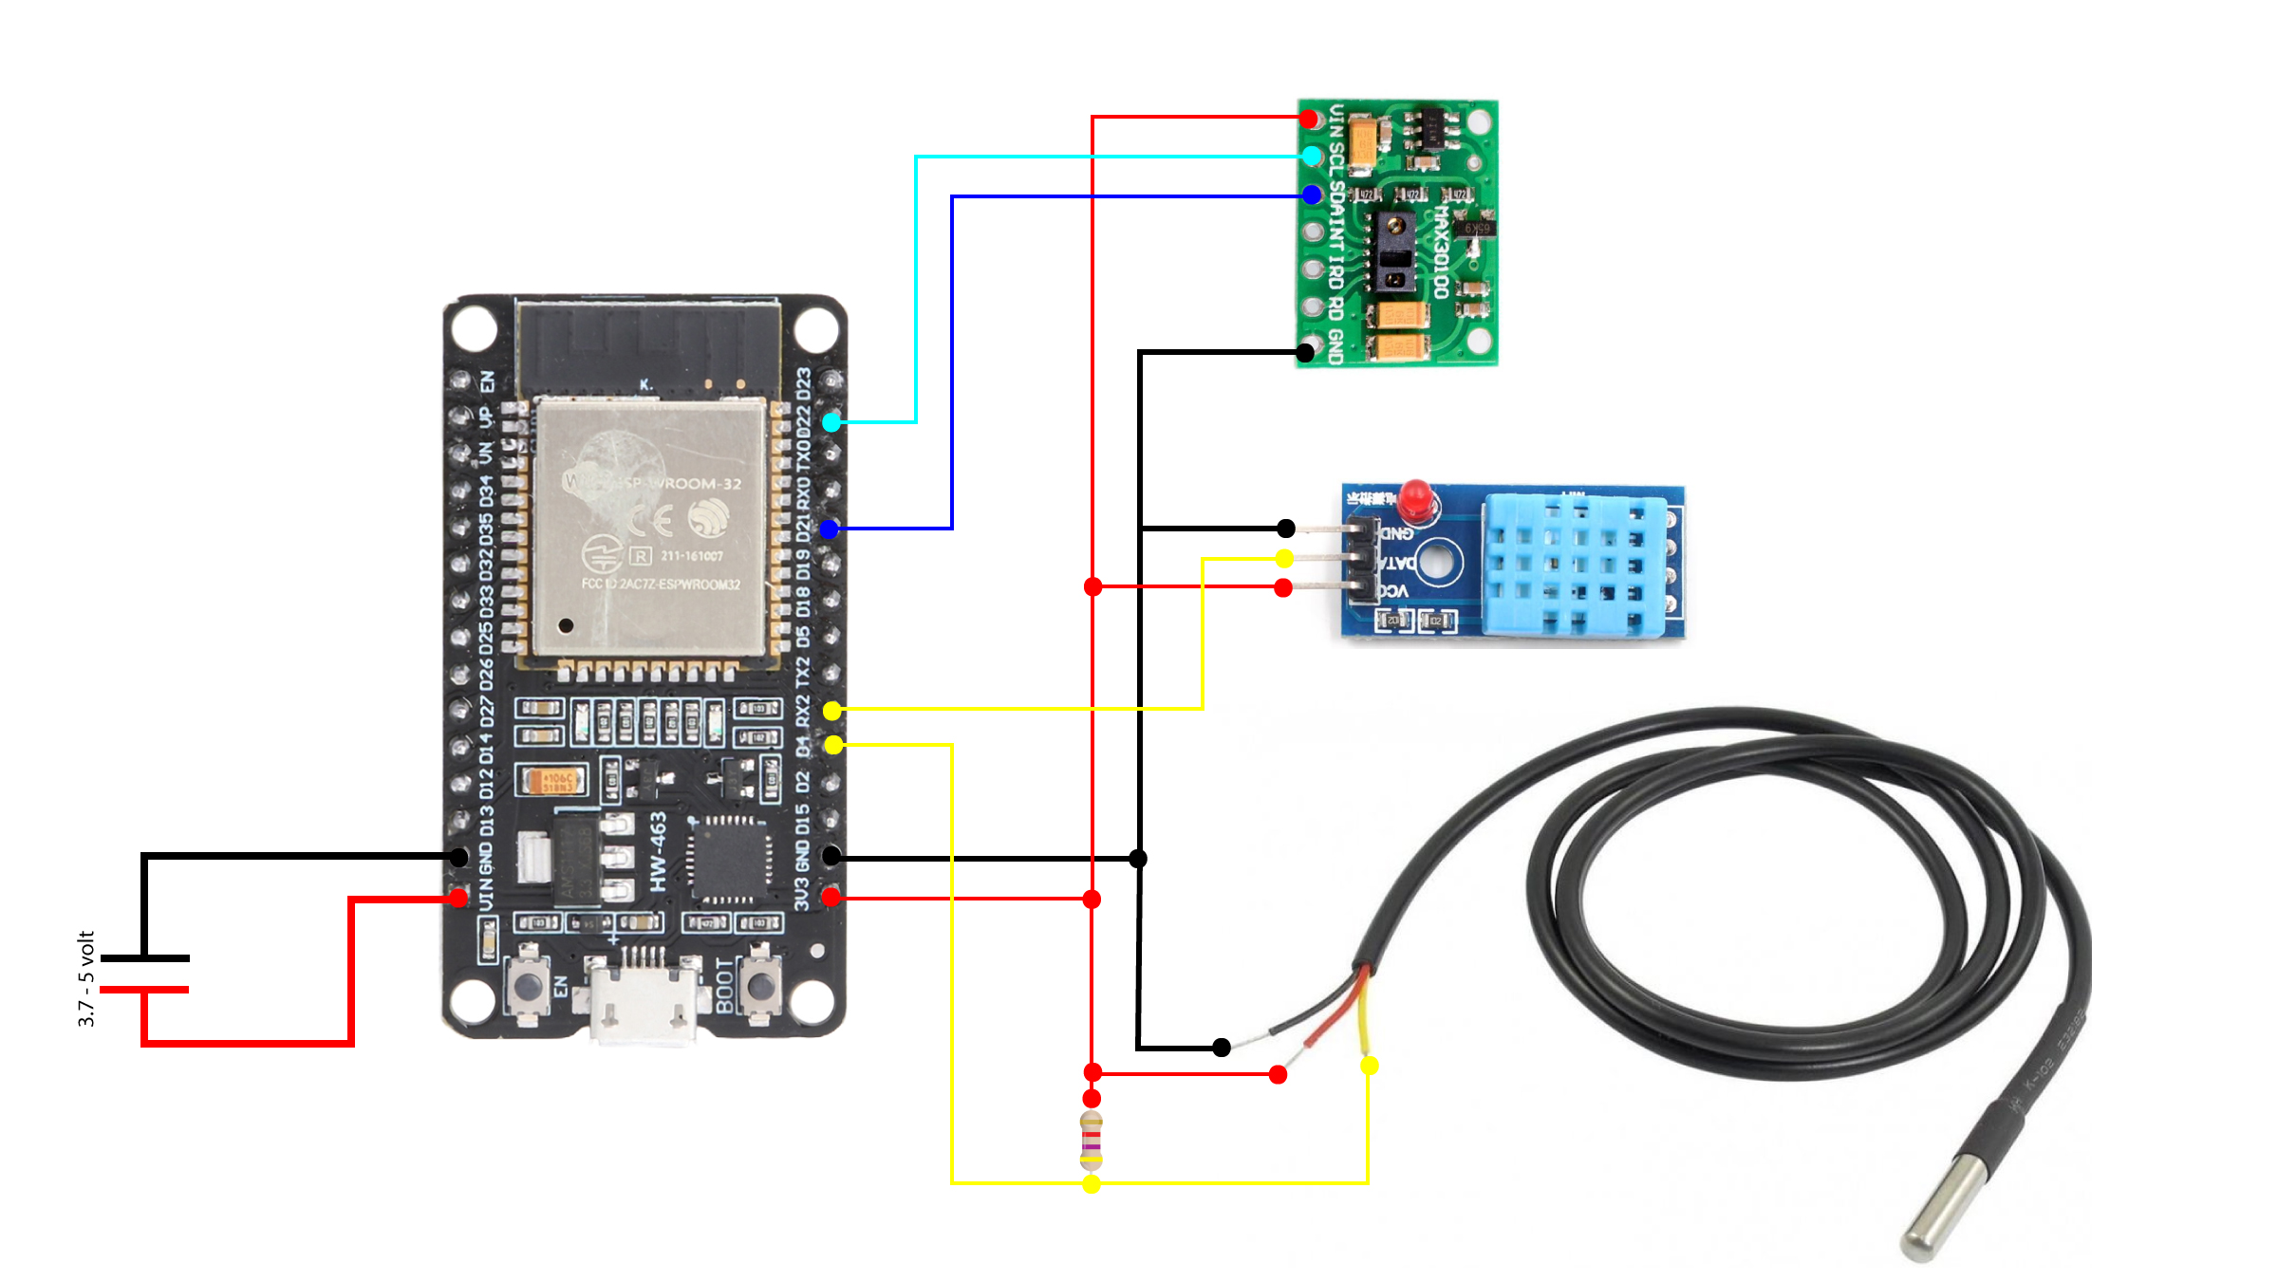
CIRCUIT DESIGN

Slide 6
OUTPUT FEATURES
Real-time vital signs displayed on 16×2 LCD
Cloud-based Blynk dashboard with live data visualization
Automated alert notifications when thresholds exceeded
Historical data logging for trend analysis

Slide 7
CONCLUSION
IoT Patient Health Monitor System provides a scalable, affordable solution for remote healthcare monitoring. With real-time data transmission, cloud storage, and physician alerts, it revolutionizes patient care delivery.
This technology bridges the gap between patients and healthcare providers, enabling proactive interventions and improved health outcomes.

Slide 8
Thank you !

